Slide 1
Project-4b Exploratory Data Analysis Of Large-Scale Industry Dataset NextHikes Solutions By - Rakshit A Solanki

Slide 2
Project Overview
This project focuses on analyzing an industry dataset to understand the factors influencing company revenue and business performance.
The dataset contains information related to industries, geographical regions, customer base, workforce & financial indicators.
Feature engineering techniques were applied to generate meaningful variable that can improve data understanding and predictive performance.
Exploratory data analysis (EDA) was performed to identify trends, patterns & relationship among different business variables.
A machine learning model was developed to predict annual revenue based on various organizational and financial factors.
The project demonstrates how data analytics can support business decision-making through actionable insights.

Slide 3
Project Objective
Feature Engineering & Data Preparation
Transform raw business data into meaningful and analysis ready features.
Create new variables that improve data understanding and predictive performance.
Prepare a structured dataset suitable for exploratory data analysis and machine learning.
Revenue Prediction & Business Insights
Develop a machine learning model to estimate annual company revenue.
Discover patterns and relationship that contribute to revenue growth.
Generate actionable insights to support business decision making.

Slide 4
Dataset Information
Dataset Structure
The dataset contains company level information collected from various industries and geographical regions.
The dataset provides sufficient information for performing exploratory analysis and predictive modeling.
Multiple attributes are available to study business performance.
Important Variables
Industry type
Country & Region
Number of customers
Profit margin
Market rating

Slide 5
Feature Engineering
Feature Creation Process
New variables were generated from existing columns to improve analytical insights.
Date based features were extracted to capture temporal business information.
Feature engineering helped transform raw data into more meaningful variables.
Benefits Of Feature Engineering
Improves data quality and interpretability.
Enhance machine learning model.
Helps uncover hidden relationship within the dataset.
Provides additional business insights for analysis.

Slide 6
Data Cleaning Process
The dataset was thoroughly inspected to identify data quality issues before analysis.
No missing values & duplicate values found in the dataset.
Data types were verified and corrected to ensure consistency across variables.
Date columns were converted into proper datetime format for feature extraction.
Irrelevant columns were reviewed and excluded where required.
The overall data cleaning process improved data reliability, accuracy & usability.
The cleaned dataset was carefully prepared to ensure smooth execution of exploratory data analysis & machine learning algorithms.

Slide 7
Outlier Detection
Outliers were identified using the Interquartile Range (IQR) method to detect extreme values present in the dataset.
Extreme values were observed in revenue & other numerical variables.
These observations may represent highly successful organizations or unusual business cases.
Outliers can significantly influence statistical analysis and model performance.
Understanding outliers helps improve the quality or business insights and predictions.
The presence of outliers provided additional insights into companies with usually high revenue and operational scale.

Slide 8
Descriptive Statistics
Skewness
The skewness values of all numerical variables are very close to zero.
This indicates that the distribution are approximately symmetrical with minimal skewness.
Overall, the dataset does not contain heavily skewed numerical features.
Kurtosis
All numerical variables have negative kurtosis value approximately around -1.2.
This indicates a platykurtic distribution with lighter tails compared to a normal distribution.
The result suggested a balanced distribution of numerical variables with limited influence from extreme values.

Slide 9
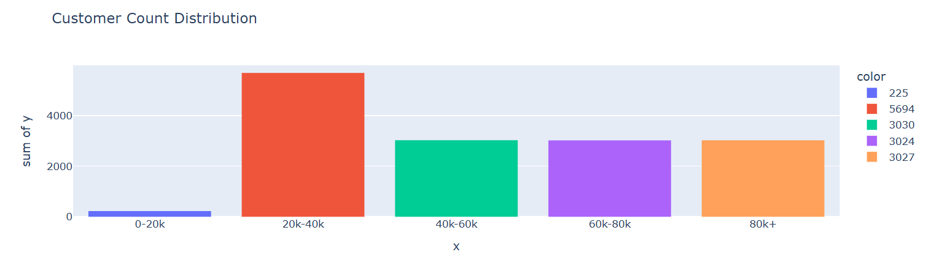
Univariate Analysis
Most companies belongs to the middle customer count ranges.
Extremely large customer bases are observed in a limited number of companies.
The distribution suggests a mix of developing and mature organizations.
Customer acquisition levels very considerably among companies.
The chart reflacts difference in market reach and business expansion.

Slide 10
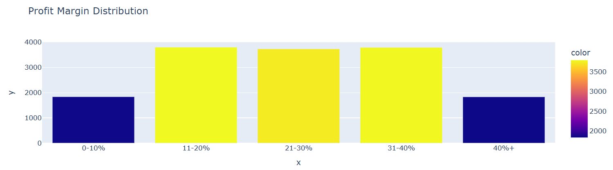
Univariate Analysis
Most organizations operate within moderate profit margin ranges.
Extremely low and extremely high profit margins are less common.
The chart suggests stable profitability among the majority of businesses.
Only a limited number of companies achieve exceptionally high margins.
Profitability varies across organizations but remains concentrated within the middle ranges.

Slide 11
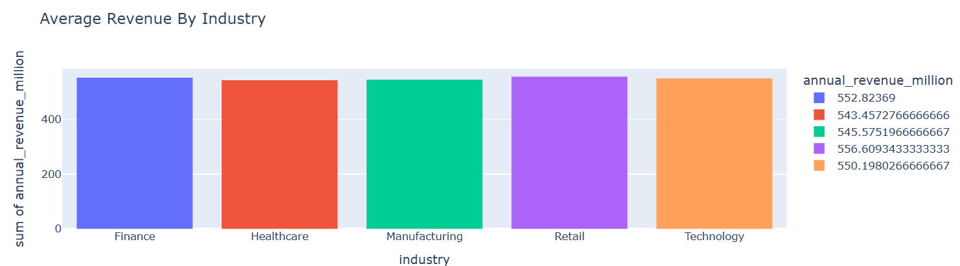
Bivariate Analysis
The chart compares the average revenue generated by different industries.
Revenue levels vary across industries despite equal representation in the dataset.
Certain industries demonstrate stronger revenue generating potential than others.
The comparison highlights difference in business opportunities among sectors.

Slide 12
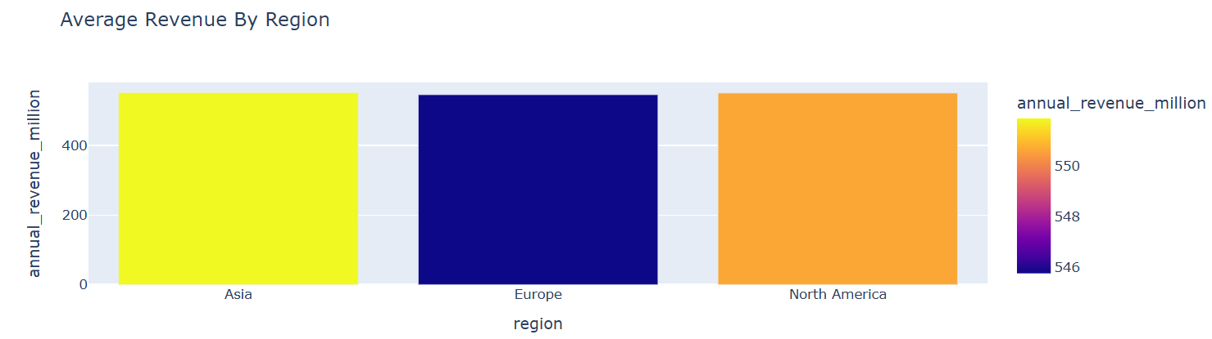
Bivariate Analysis
Average revenue differs across geographical regions.
Some regions outperform others in terms of revenue generation.
Regional market conditions may contribute to differences in business performance.
The chart highlights the importance of geographical factors in revenue growth.

Slide 13
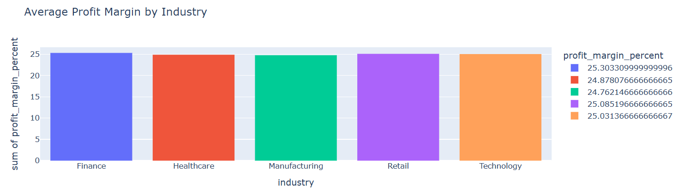
Bivariate Analysis
Profitability varies noticeably among industries.
Certain industries achieve stronger profit margins the others.
Industry specific operational models influence profitability levels.
Some sectors generate higher profits even without the highest revenue.
The chart highlights difference in financial efficiency across industries.

Slide 14
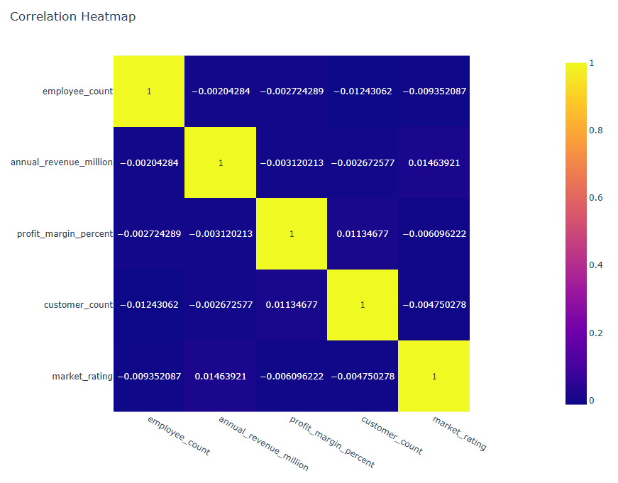
Correlation Heatmap
The heatmap visualizes relationship among numerical business variables.
Positive correlation indicate variables that tend to increase together.
Revenue shows meaningful relationships with selected business indicators.
Some variables exhibit weak correlation, suggesting limited influence on one another.
The chart helps identify important features for predictive modeling.

Slide 15
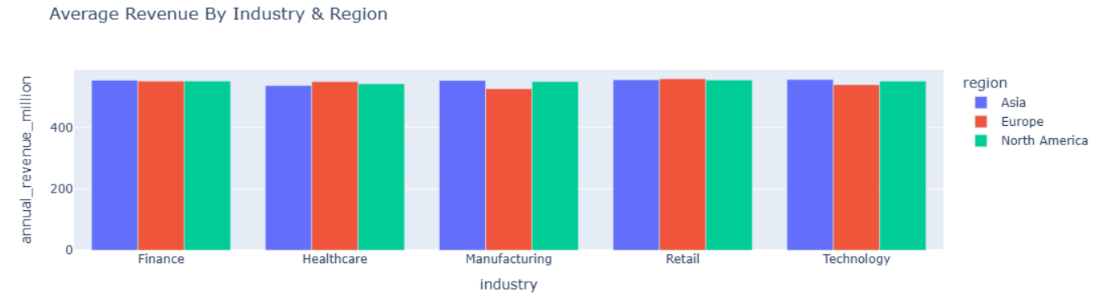
Multivariate Analysis
Revenue performance varies when both industry and region are analyzed together.
Certain industries perform better in specific geographical regions.
The interaction between industry and region provides deeper business insights.
Revenue trends cannot be explained by a single variable alone.
The chart highlights the importance of considering multiple factors when evaluating business performance.

Slide 16
Machine Learning Results
Linear Regression
Linear regression was selected as the predictive model for estimating annual company revenue.
The model establishes relationships between independent variables and the target variable.
It provides a simple and interpretable approach for revenue forecasting.
Model performance was evaluated using standard regression metrics.
Model Evaluation Metrics
Mean absolute error (MAE) = 248.3300
Mean squared error (MSE) = 82469.2700
Root mean squared error (RMSE) = 287.1700
R2 score = -0.0001

Slide 17
Key Observations
Revenue distribution shows noticeable variation across industries and regions.
Feature engineering improved the quality and usefulness of the dataset.
Feature engineering played a significant role in enhancing the analytical value of the dataset and improve model readiness.
Industry characteristics play an important role in determining business performance.
Customer related & financial variables demonstrate meaningful relationship with revenue.
Correlation analysis helped identify influential variables for prediction.
Data driven analysis reveled valuable business trends and patterns.

Slide 18
Business Insights
Organizations should focus on key business indicators that show strong relationship with revenue.
Industry specific strategies can improve financial performance and market competitiveness.
Regional analysis can help identify attractive markets for future expansion.
Customer acquisition and retention remain critical factors for business growth.
Data driven decision making can improve operational efficiency and revenue generation.
Predictive analytics can assist business in forecasting future performance and planning effectively.

Slide 19
Conclusion
The project successfully analyzed industry data using exploratory data analysis and machine learning techniques.
Feature engineering enhanced the overall quality and usefulness of the dataset.
Several important business patterns and relationships were identified through statistical analysis.
the project highlights the importance of data analytics in supporting business decisions.
The finding highlights the potential of machine learning and data analytics in solving real world business problems.
Overall, the analysis provides meaningful insights that can contribute to organizational growth and strategic planning.

Slide 20
Reference Links Used For Learn
https://www.geeksforgeeks.org/data-analysis/exploratory-data-analysis-in-python/
https://www.ibm.com/think/topics/data-cleaning
https://plotly.com/python/bar-charts/
https://plotly.com/python/box-plots/
https://www.geeksforgeeks.org/machine-learning/machine-learning/
https://www.geeksforgeeks.org/machine-learning/ml-linear-regression/
https://www.youtube.com/watch?v=xi0vhXFPegw

Slide 21
Thank You

